Slide 1
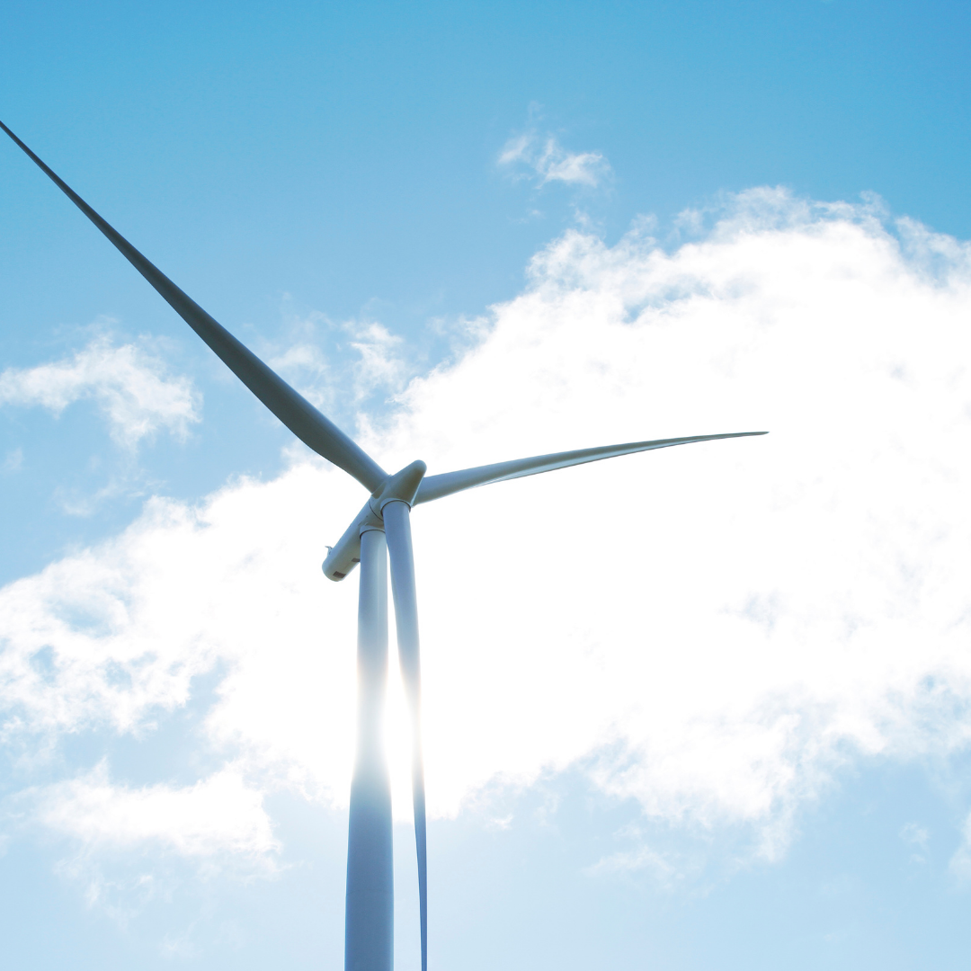
VERTICAL
AXIS WIND TURBINE FOR HIGHWAY APPLICATION
BME-A MTE PROJECT
SUBMITTED TO
DR. M. ZUNAID
SUBMITTED BY
PARTH JOHRI 2K20/B17/33
DHRUV BIHANI 2K20/B17/44

Slide 2
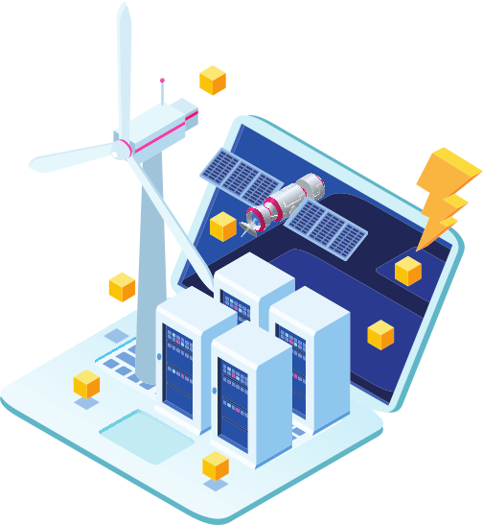
INTRODUCTION
The energy produced by this blowing wind is called as wind energy.
Electricity plays a vital role in the development of the country, so the production of electricity is one of the main aims of the country. About 68% of the production of electric energy is based on the thermal power plant, where fossil fuels, coals, diesel are used for power generation and which is very less available and These fuels also create pollution, greenhouse effect, and global warming. Therefore power generation with the help of non-conventional resources such as wind is increasing day by day and this type of power generation is very clean and safe.

Slide 3

The moving vehicle on highway may be all types such as small or heavy vehicles. Whenever vehicle moves on both side of the highway divider then some pressurized air is produced due to the speed of vehicle. This pressurized air is strike on the blade of vertical axis wind turbine and turbine makes a rotation. The shaft of the vertical axis wind turbine is connected to generator with the help of gear mechanism. The generated electricity is an alternating quantity; the output of the generator is rectified by rectifier and stored in the battery. The solar system is mounted on besides of the vertical axis wind turbine, the function of the solar system not only generate the electricity but also provides the constant air flow towards the blade of vertical axis wind turbine. The position of solar plates is in inclined nature at an angle 45 degree.
WORKING PRINCIPLE
A solar cell or photovoltaic cell is an electrical device that converts the energy of light directly into electricity by the photovoltaic effect, which is the physical and chemical phenomenon. It is photoelectric cell, defined as a device whose electrical parameter such as current, voltage or resistance varies when exposed light. Solar cells are the building blocks of photovoltaic modules. The generated electricity is stored in the battery. The stored energy used as a street lighting and domestic purpose.

Slide 4


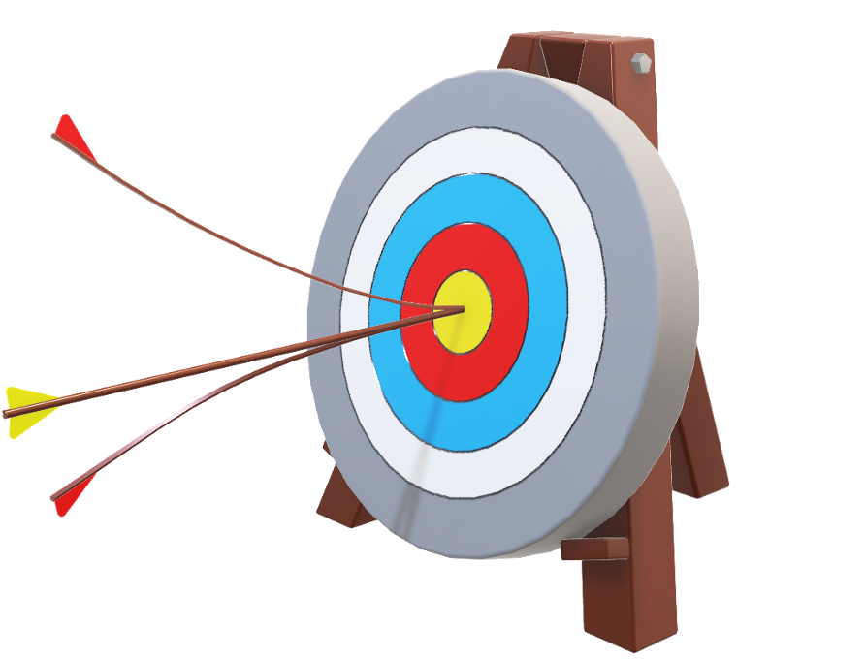
OBJECTIVE
The main objective of our project is to use the maximum amount of wind energy from vehicle running on highways. The wind turbine will be placed in divider so that the tangential acting airflow from both sides of the road due to moving vehicle will help the turbine to rotate. The variation of blade angle is made so as to get the maximum output and blades are then fixed.
The unused considerable amount of pressurized air used to drive the vertical axis wind turbine from which the kinetic energy of turbine is converted into electrical energy. The main aim of this project to reduce the pollution produced burning of fossil fuel. The generated energy by VAWT and solar system are stored in a battery and this stored energy which can be used street lighting, toll gates or in future to provide the charging node to the electrical vehicle.

Slide 5

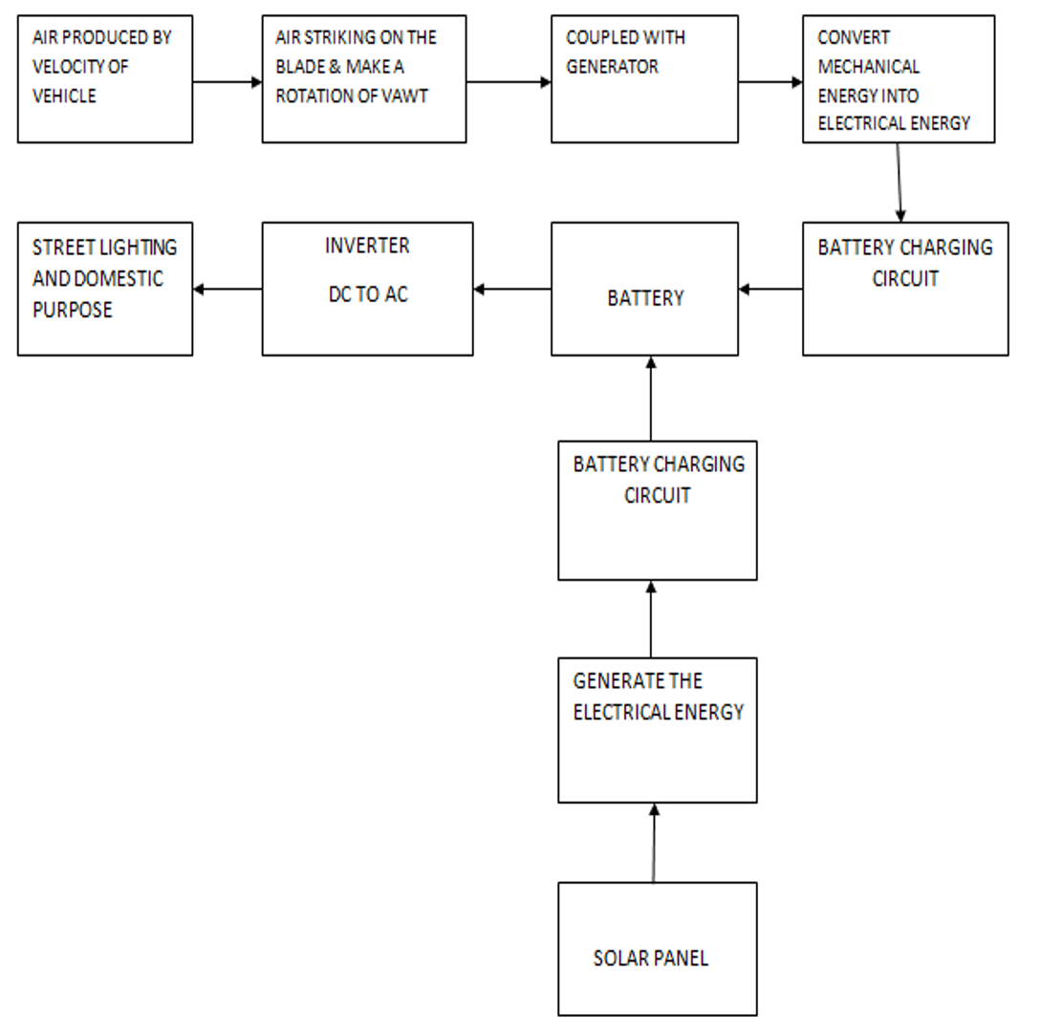
BLOCK DIAGRAM

Slide 6
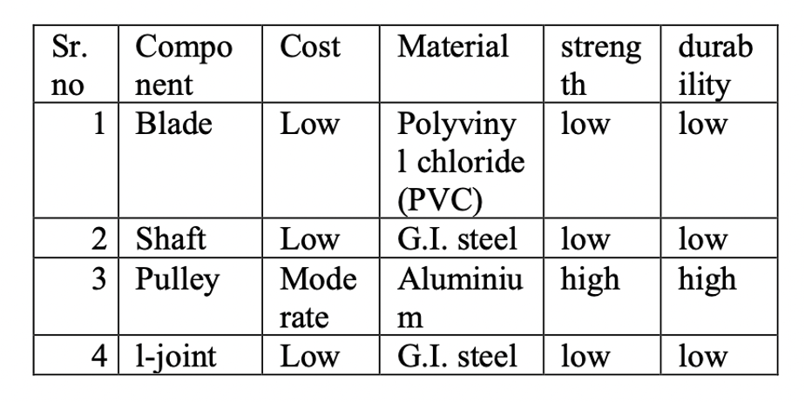
MATERIAL USED
The materials for
blades
shaft
pulley
disc
L-Joints
are given ahead.

Slide 7

DESIGN OF COMPONENTS
Design calculation of the VAWT is done by considering the speed of the air impacting blades of the turbine it starts rotating, blades connected to a generator that generates the power. The power is used for some useful work
1) DESIGN OF BLADE
2) DESIGN OF SHAFT
3) DESIGN OF PULLEY
4) DESIGN OF BEARING

Slide 8

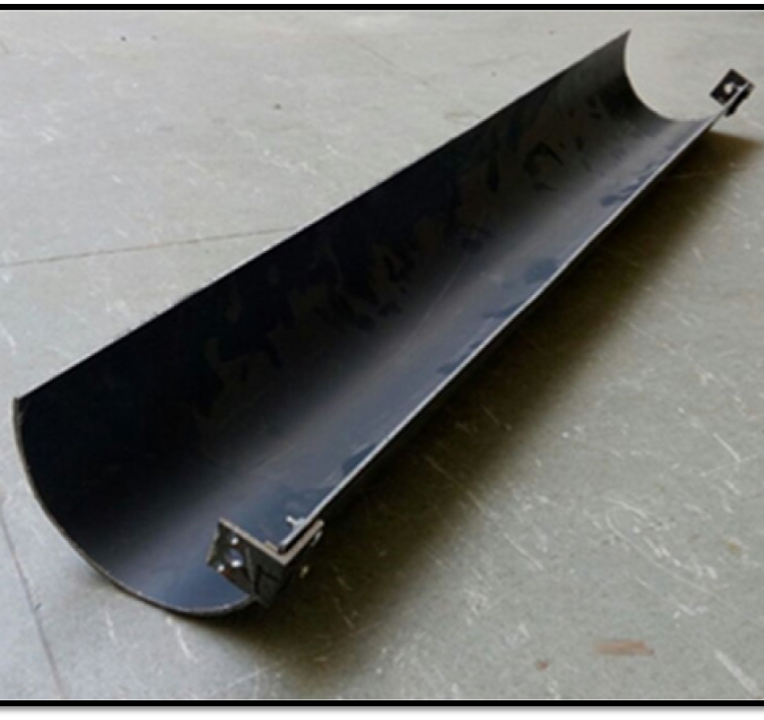
DESIGN OF BLADE
The blade is designed in semicircular shape so as one blade passes another blade comes in the position of first. 8 blades are used so as to use maximum utilization of wind from the air and moving vehicles.
A= d*h
d= diameter of the rotor (m)
h= height of the blades (m)
So,area = (0.75*0.4)
= 0.3 sq. m.
This height and diameter are chosen due to the restriction of the use of more rotor diameter due to the availability of less space to install on the highway.
The blade is made of PVC pipe. This material is taken because it is low-cost and the weight of these pipes is also less, due to this the project weight also decreases, and due to this the rotational speed also increases so as to output. The weight of each blade is 200gm and therefore the total weight of 8 blades is 1.6 kg.

Slide 9
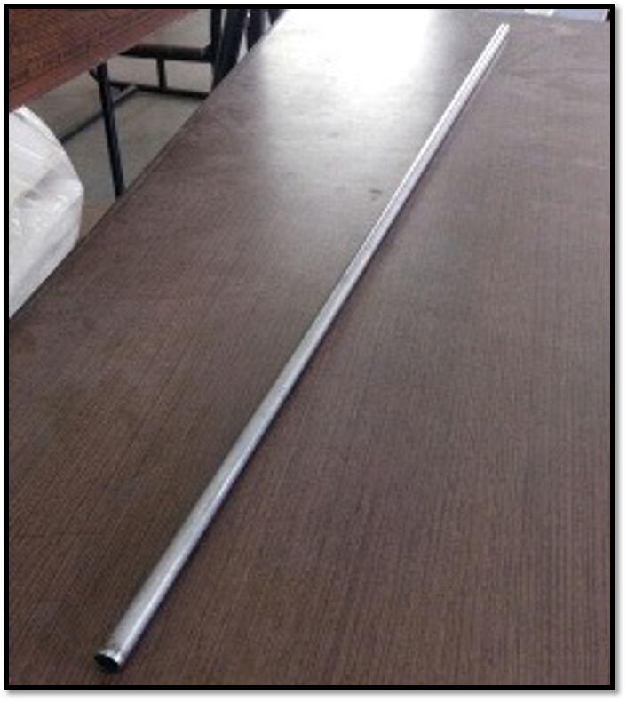
DESIGN OF SHAFT
While designing the shaft it should be properly fitted to blade.. The shaft has a diameter of 10mm so as to be easily be fixed in the disc and at the top and bottom ends mild steel plates are attached of thickness 2mm.
Stress acting on shaft ρ=P/A
600 = 0.2898 / π/4 d*d So,
d = 0.0201
Material used for shaft = Mild steel Syt = 300Sut = 500-600

Slide 10
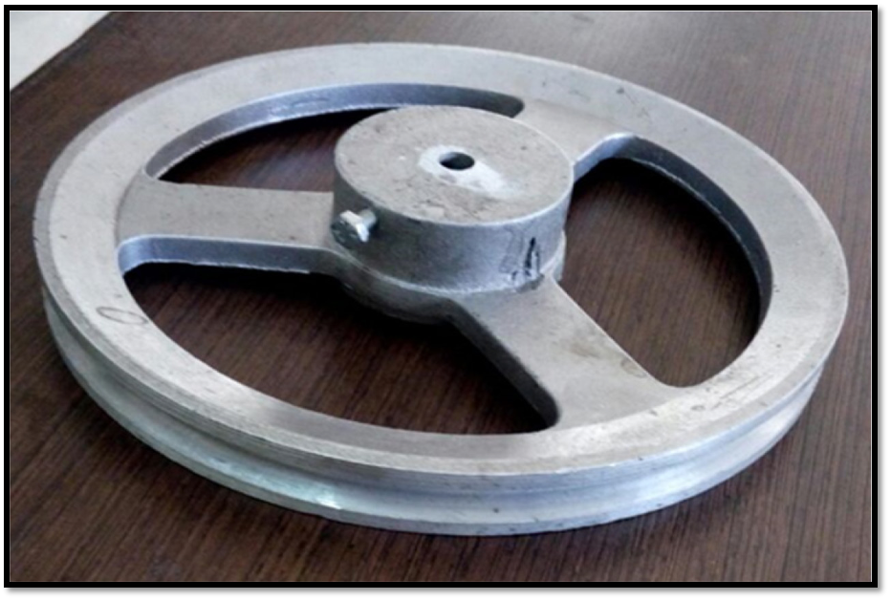
DESIGN OF PULLEY
There are 2 pulley used one big pulley and one short. Big pulley is attached to the shaft and lower pulley is attached to the dimmer dynamo. big pulley is made up of aluminum alloy so as to decrease its weight so it can rotate freely. Both the pulley are attached with the help of a belt. This pulley increases the rotational speed of the turbine.
Diameter of big pulley: 226 mm Inner diameter: 75 mm
Diameter of small pulley: 35 mm Inner diameter: 10mm

Slide 11
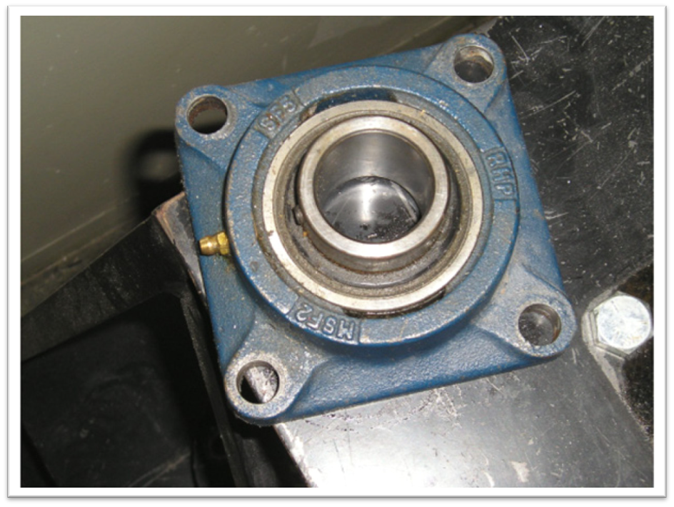
DESIGN OF BEARING
For the smooth operation of Shaft, bearing mechanism is used to .. The Bearing has diameter of 1cm. Bearing are generally provided for supporting the shaft and smooth operation of shaft. For Ease of Performance We have used Ball bearing

Slide 12
CONCLUSION
The VAWT is designed and fabricated in such a way that the it can able to capture wind from all the direction, power developed from the project is 28W for a speed of 6.1m/s, the efficiency of VAWT can be increase by changing the size and shape of the blade, the theoretical and experimental result is varying because in theoretical calculation we consider the wind is hitting all the eight turbine blades, practically it is not.
Our work and the results obtained are very encouraged that vertical axis wind energy conversion are plausible and potentially very contribute to the production of the clean renewable electricity from the wind even under low ideal sitting conditions. With the idea on highway, it will power up street lights. In most cities, highways are a faster route for daily commute and in need of constant light makes this a very efficient way to produce natural energy.
This system is environmental friendly. The working model of our project is combined energy source with solar system and vertical axis wind turbine system which is a good and effective solution for power generation, basically this system involves the combination of two energy system, suppose anyone source fails to generate another source will keep generating the electricity and will give the continuous power to the load. The renewable energy sources such as solar and wind energy are used to generate the electricity.

Slide 13
FUTURE SCOPE
1) As this is the proposed model it is built at very low cost. Instead of plastic, if Fiber Reinforce Plastic (FRP) is used it will yield to more output.
2) The Word hybrid means a thing which is made by the combination of more than one element. In energy system, electricity can be produced by more than one source at a time like Wind, solar, biomass etc. There are various methods to generate hybrid energy like wind-solar, Solar- diesel, Wind- hydro and Wind – diesel. Among the above listed hybrid energy generation module the wind- Solar hybrid module are more crucial because it is available abundant in nature and it is also very much environment friendly.
The hybridization in India has large prospect because over 75 % of Indian household face the problem like power cut especially in summer.
So solar panels can be installed on the top of the turbine so that the efficiency increases.
3) Development of effective alternator and dynamos can be used to wind energy from relatively small winds.
4) By setting different angles at different speed of the turbine can also be done as a future work or scope.

Slide 14

Thank you!
Submitted by
Parth Johri 2K20/B17/33
Dhruv Bihani 2K20/B17/44

